Slide 1
Hurricane Harvey – Best Track Analysis
Data Analytics & Visualization 2020

Slide 2
Project Information
Project Team (Group 6): Reza Abasaltian, Vincent Adams, Jeremy Jones, & Rob Pascarella
Project Scope: As a group we have decided to gather data from offshore weather stations and platforms to perform an analysis of weather attributes as they correlate to the intensity of Hurricane Harvey.
Weather attributes analyzed:
Wind Speed
Water Salinity
Air Pressure
Water Temperature
Air Temperature

Slide 3
Questions
What weather attributes contributed the most, if any, to the intensity of Hurricane Harvey?
Did water temperature affect intensity of the hurricane the most?
Did air temperature affect the intensity of the hurricane the most?
Did air pressure affect the intensity of the hurricane the most?
Did water salinity affect the intensity of the hurricane the most?
We plan to answer these questions by utilizing P based analysis. Graphically we will represent our data in scatter plots to show correlations as well as box plots to show our outliers in within the data set.

Slide 4
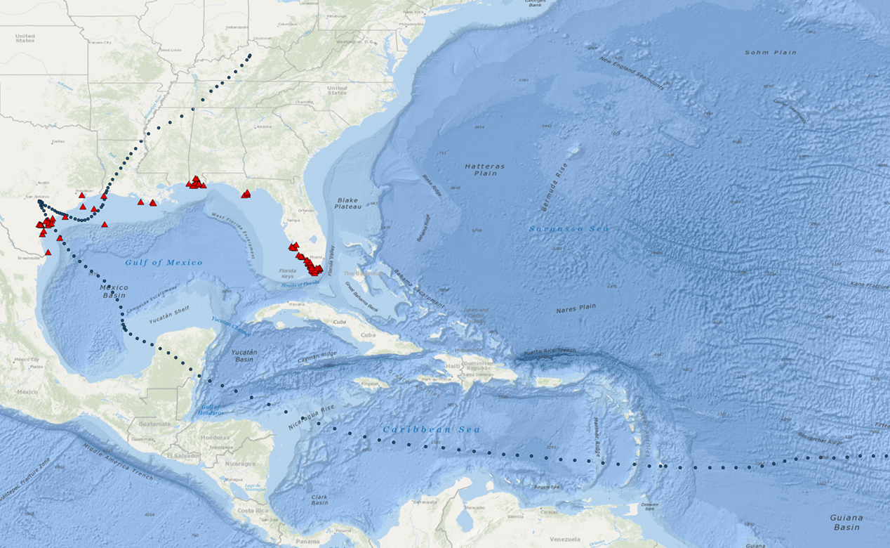
Project Data Sources
Data Retrieval:
CSV
http://data.gcoos.org/waf.php
https://www.nhc.noaa.gov/data/tcr/AL092017_Harvey.pdf
Took data created a csv for best track
API
GMaps

Slide 5
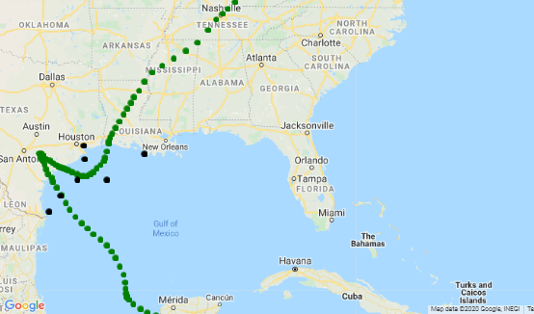
Project Data Points Location
Selected Data Points:
A = 42043
B = 42044
C = 42047
D = 8764314
E = 8770613
F = TABS-X
G = 42019

Slide 6
Data Cleanup

Slide 7
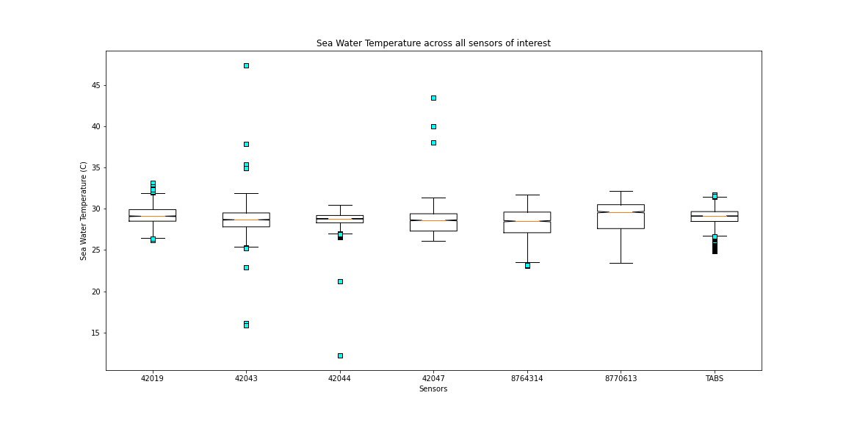
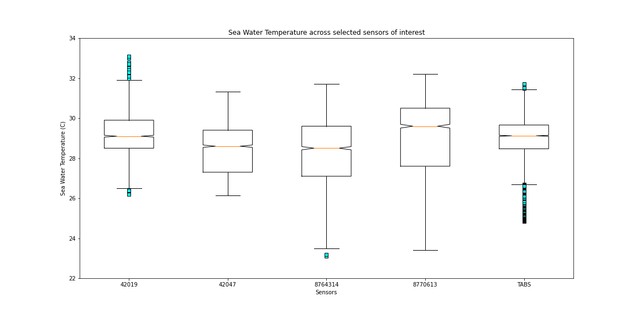
Water Temperature

Slide 8
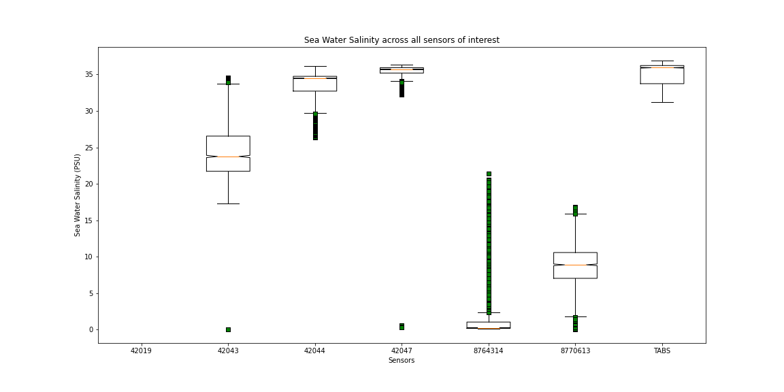
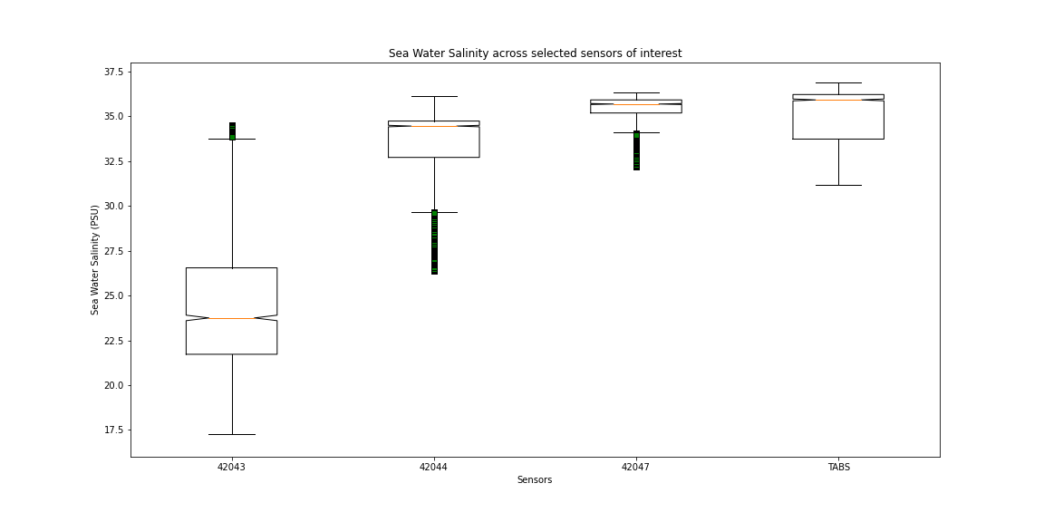
Water Salinity

Slide 9
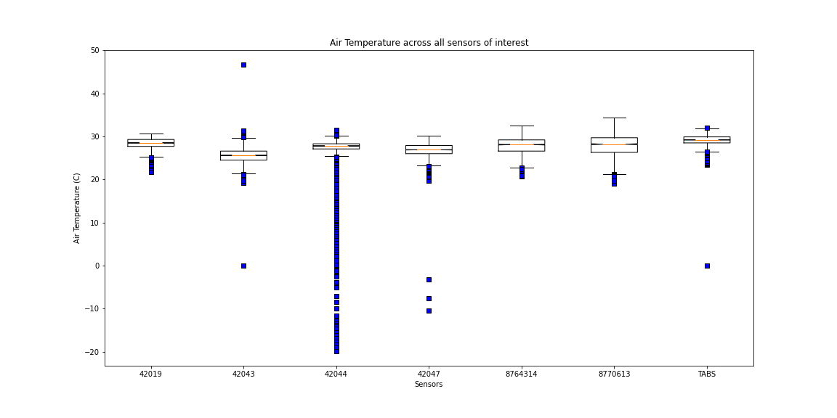
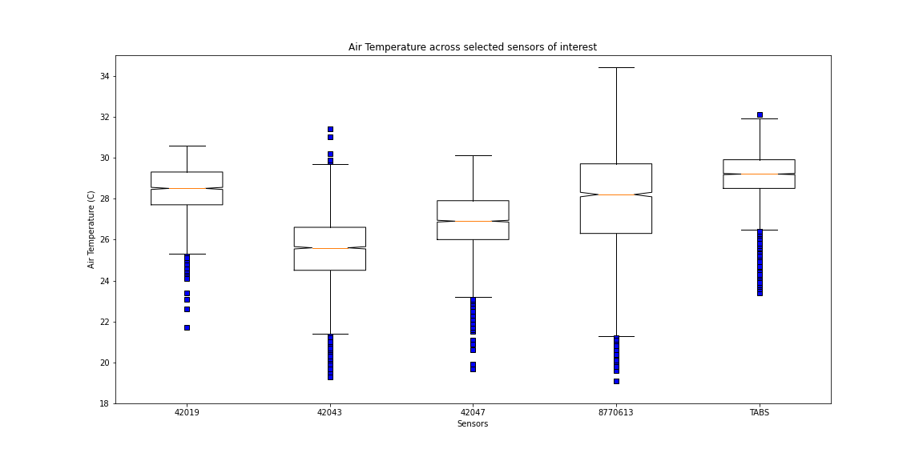
Air Temperature

Slide 10
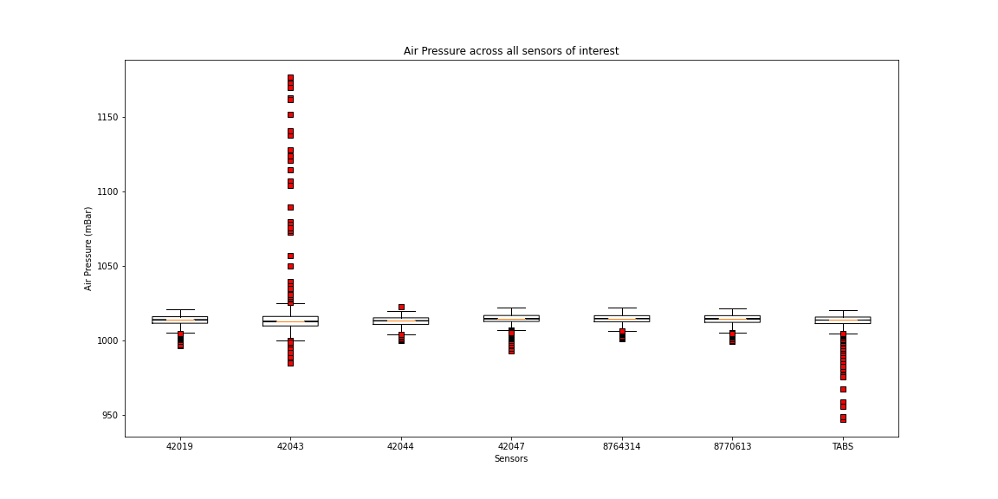
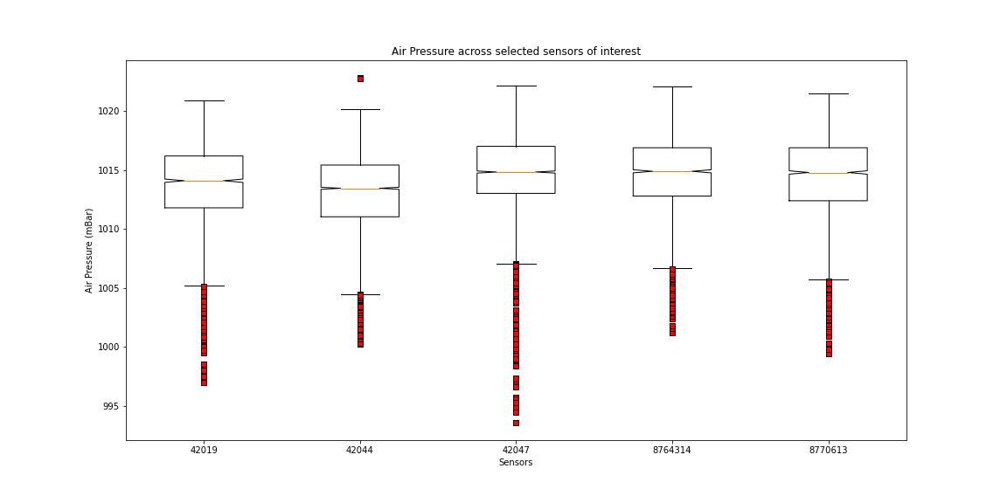
Air Pressure

Slide 11
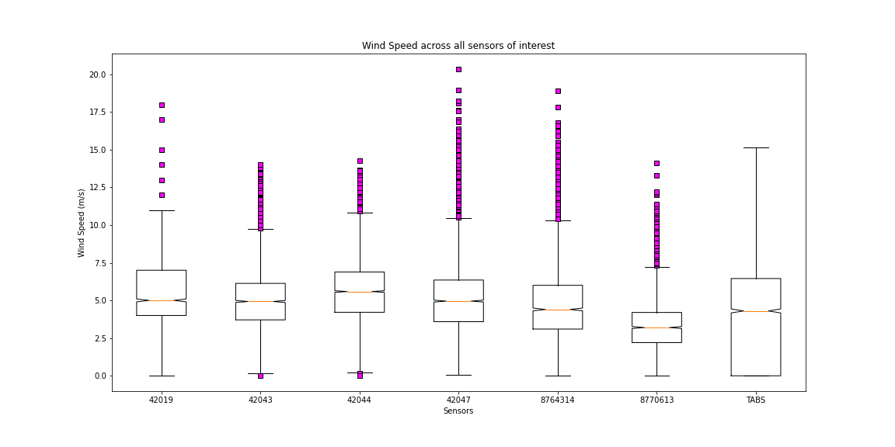
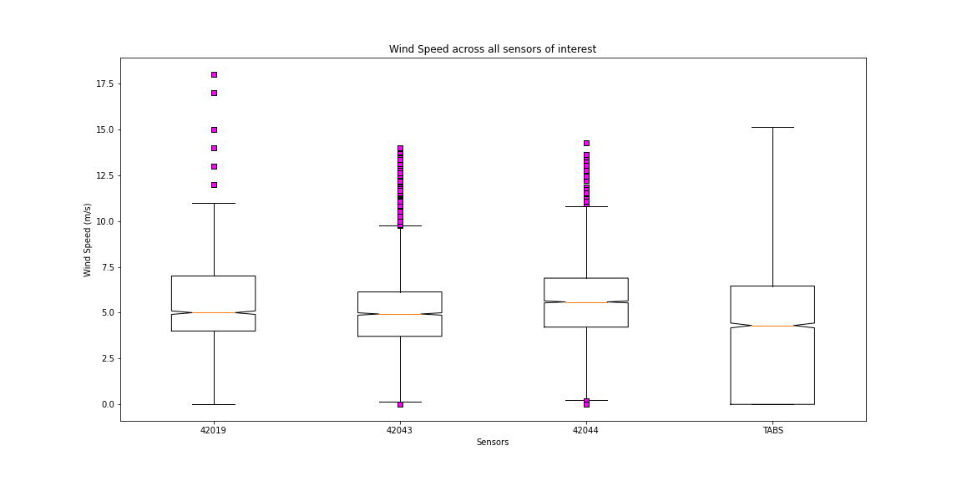
Wind Speed

Slide 12
Limitations
Limited data points within the direct path of the storm.
Incomplete data sets on some of the original targeted data points.
Erroneous data on some the data sets during the actual Hurricane.

Slide 13
Conclusions

Slide 14
Findings

Slide 15

Questions

Slide 16


